Slide 1
ODL ERP Upgrade:
What to Expect
2024

Slide 2
BACKGROUND

Slide 3


WHAT DOES ERP UPGRADE MEAN?
CURRENT STATE:
Oracle EBS (On-Premise)
FUTURE STATE:
Oracle Fusion (Cloud)
Notes:
We are moving from Oracle EBS, or E-Business Suite, to Oracle Fusion. In addition to being a more modern technology, we are moving to a cloud-based ERP with Oracle Fusion, which is more secure, scalable, and future-proof than our on-premise ERP today. We chose Oracle Fusion after an extensive research and selection process, and we are very happy with the decision we made. As a side benefit, because we remained with Oracle, you will not see many changes to your interactions with us.

Slide 4
WHY UPGRADE?
01
02
03
Growth & Innovation A contemporary and robust software suite empowers progress.
Employee Value Our employees can do so much more with the correct tools in their toolbox.
Organizational Excellence Improved processes and automation make us more agile & responsive.
Notes:
We undertook this upgrade because it aligned with our short- and long-term company goals:
Growth & Innovation: We’re in a season of tremendous growth, and we needed an ERP that could grow with us. Oracle Fusion gives us the robust features we need to grow all aspects of our business.
Employee Value: Our fantastic people can only do their best work with the right tools. We’re empowering our teammates to create more value for each other and for you, our customer.
Organizational Excellence: We have aligned our processes with industry best practices and built more automation into every part of the business, which makes us nimbler and cuts down on waste.

Slide 5
WHAT IS CHANGING?
Notes:
Now, we’ll go over the changes you can expect to see.

Slide 6
WHAT’S CHANGING FOR YOU?
What You’ll Experience:
More efficient use of time
More accurate information
What You’ll See:
Document design changes
Item description changes
New order intake email address
Notes:
Thankfully, it’s not much. You’ll feel, more than see, your ODL contacts spending time on what matters to you and less on what doesn’t, and in the quality of the information that both me, the salesperson, and your customer service representative can provide.
You’ll see in the next few slides all of the document design changes, item description changes, and order entry changes we’re making as part of this upgrade. There are no changes to shipping labels.

Slide 7
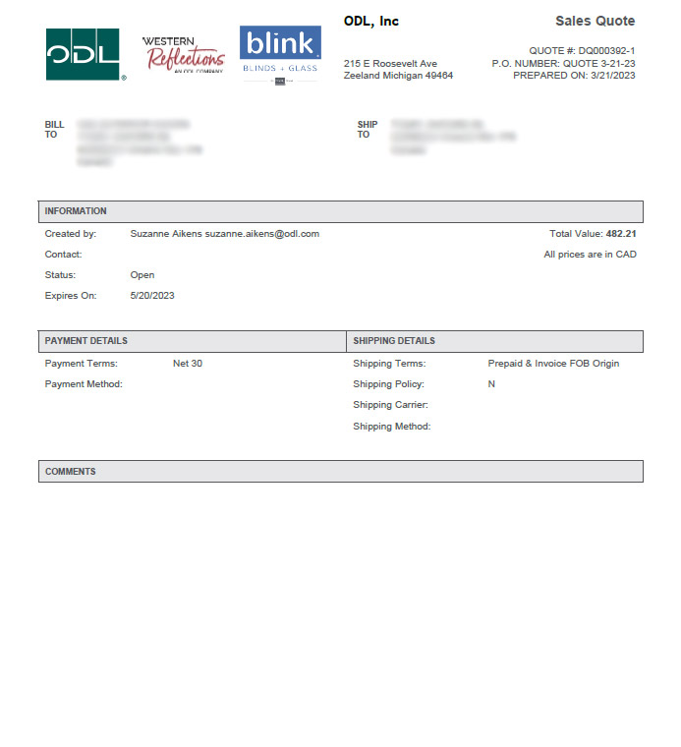
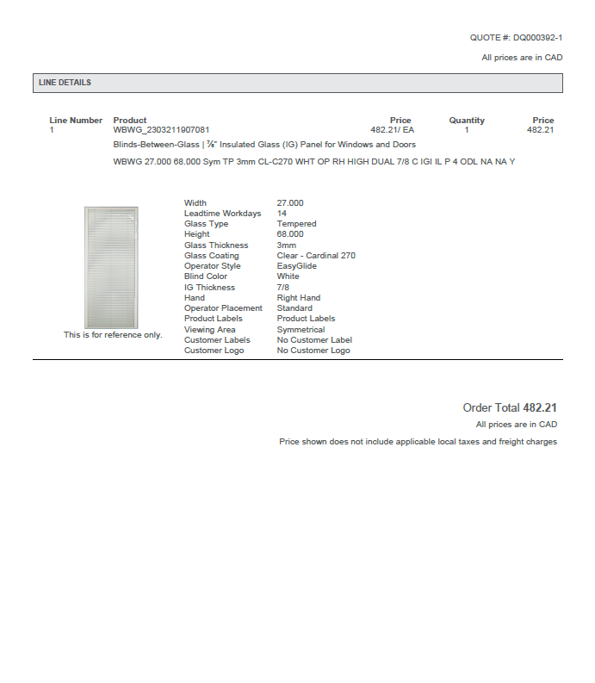
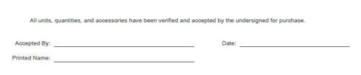
SALES QUOTES
OLD VERSION
Notes:
This may be familiar to you as our old pricing quote “document”.

Slide 8
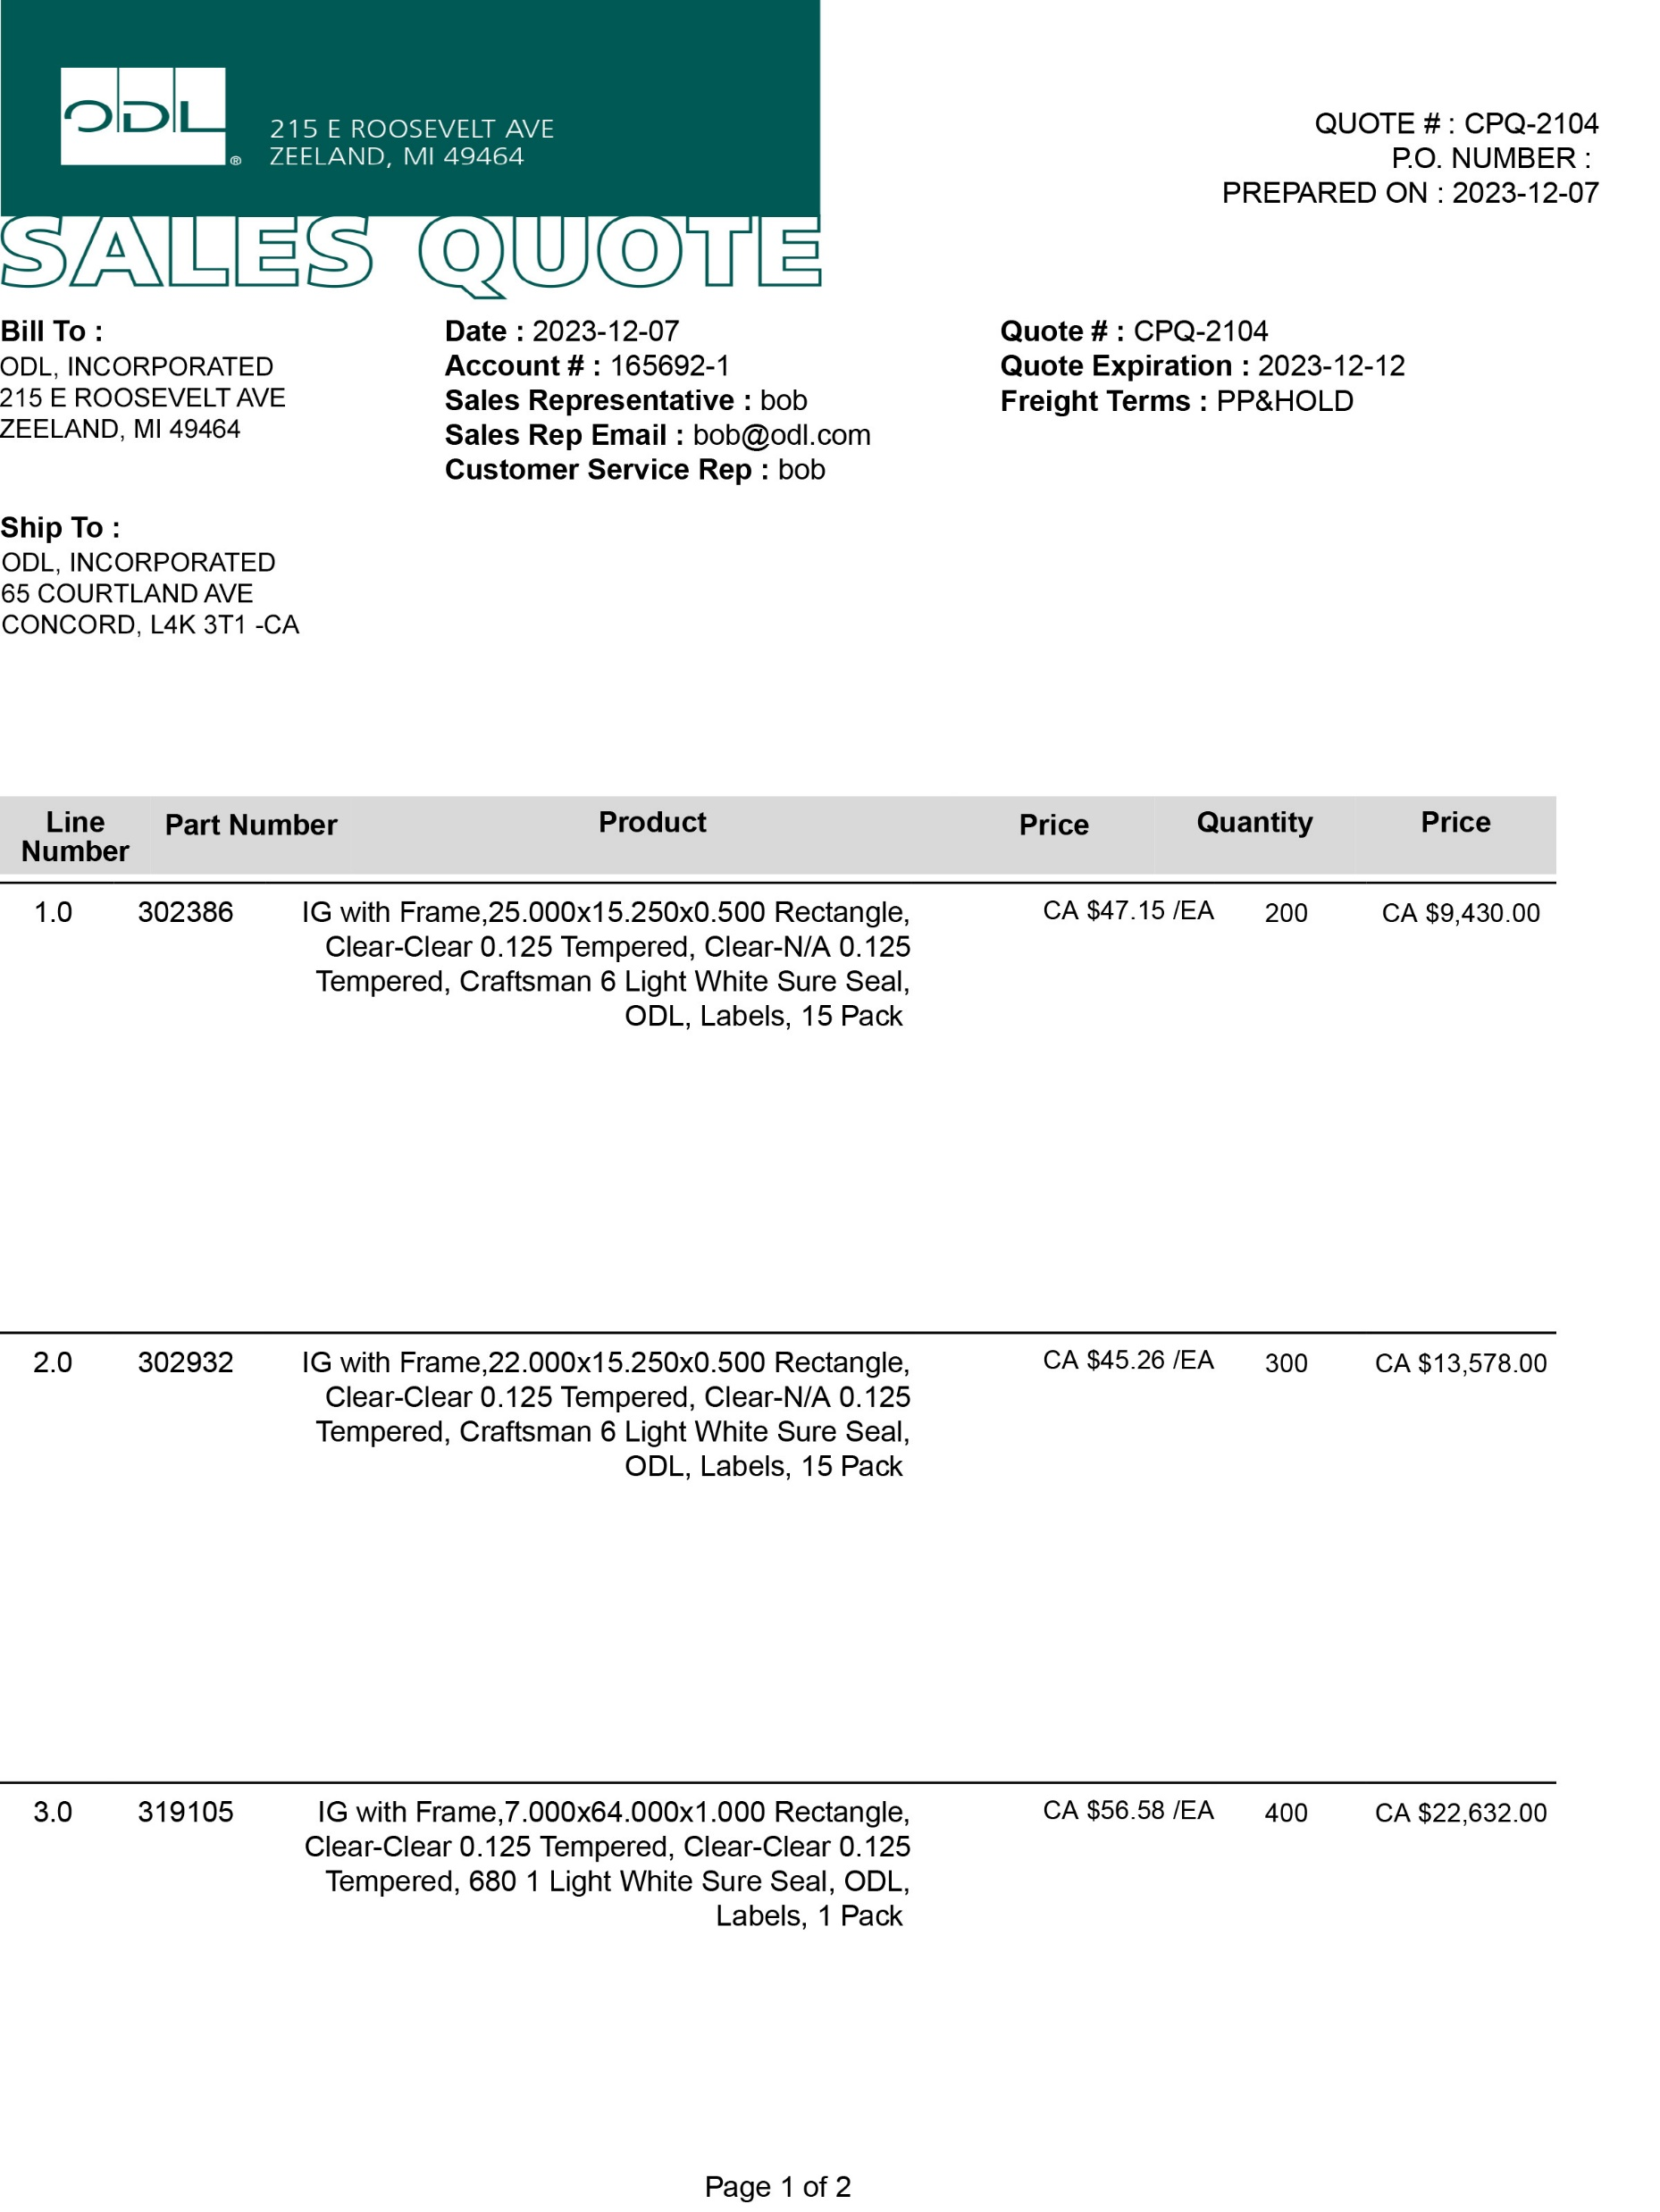
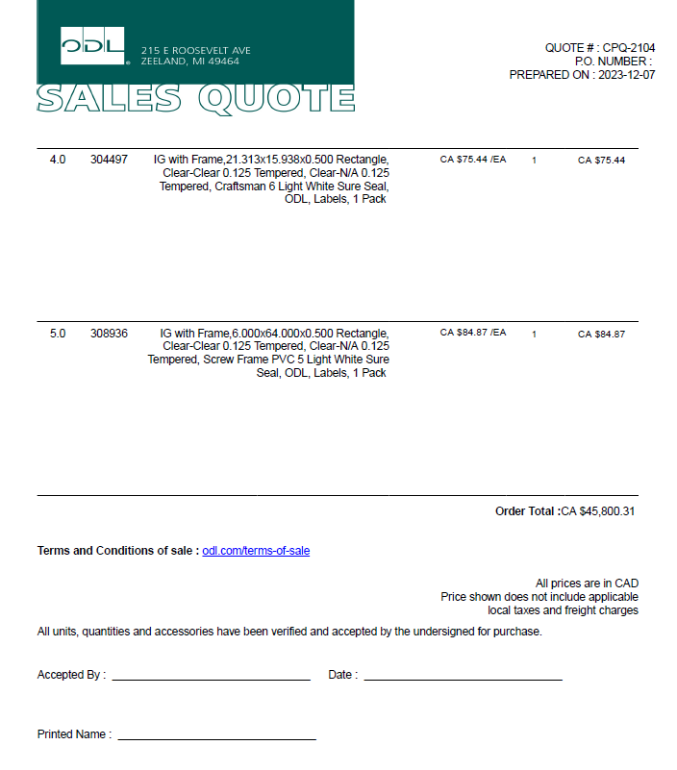
SALES QUOTES
NEW VERSION
Notes:
It’s changing to a more formal quote document with more information. We will be asking for signed acceptance of quotes moving forward.

Slide 9
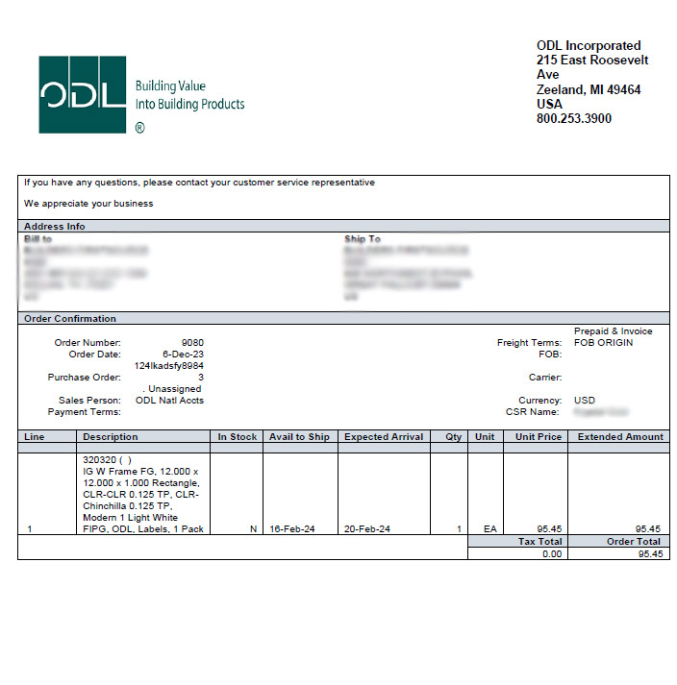
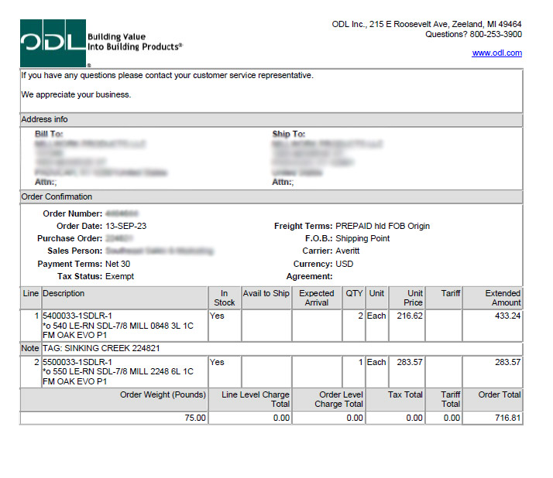
ORDER ACKNOWLEDGEMENT
OLD VERSION
NEW VERSION
Notes:
Order acknowledgements were deliberately designed to be as close to what you receive today as possible. The biggest difference is the item description, which we’ll talk about in more detail.

Slide 10
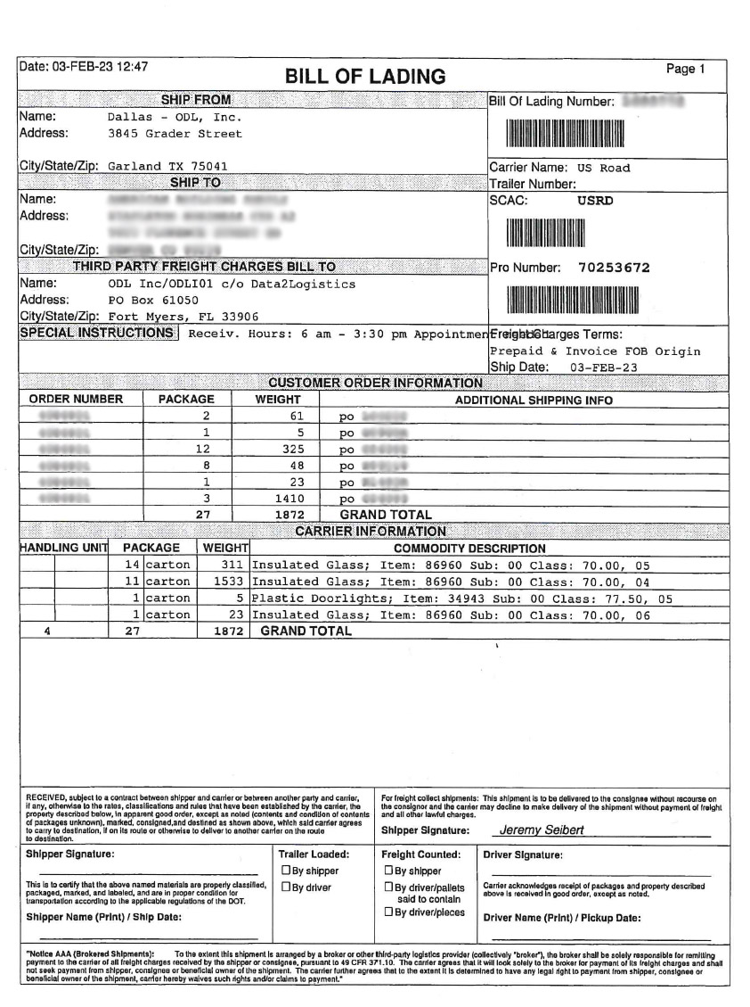
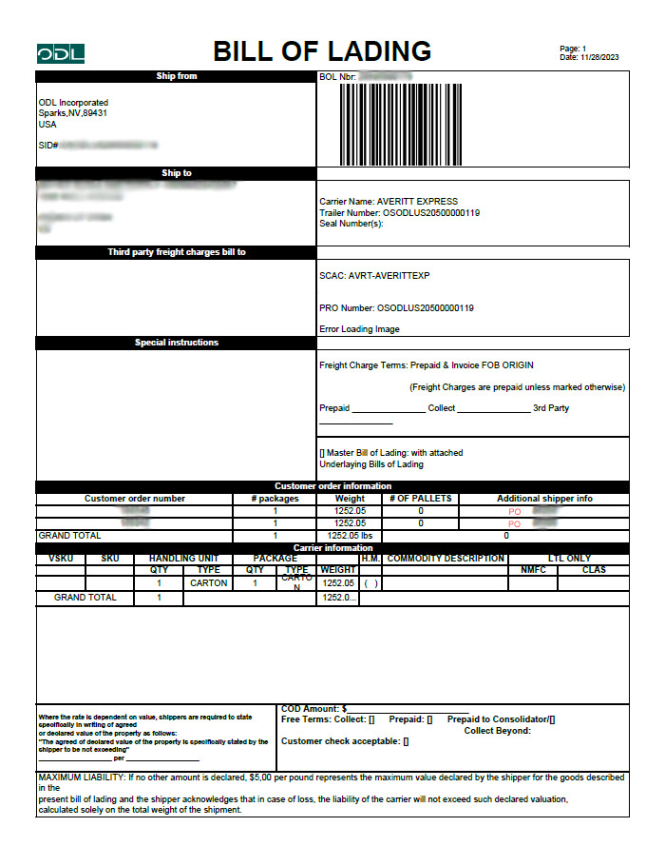
BILLS OF LADING
OLD VERSION
NEW VERSION
Notes:
Bills of lading will also be very similar to what you receive today, though the document layout is different.

Slide 11
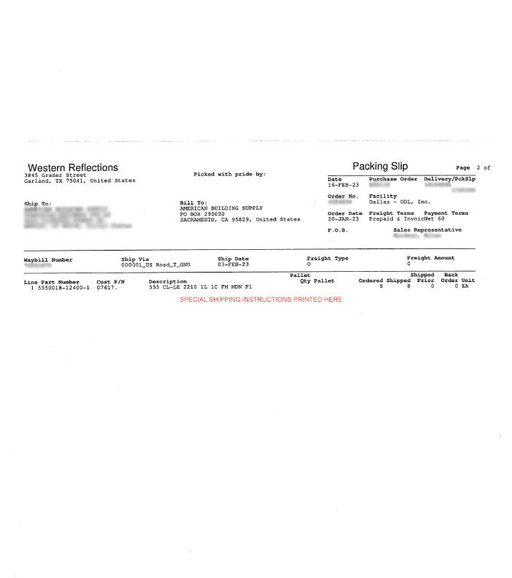
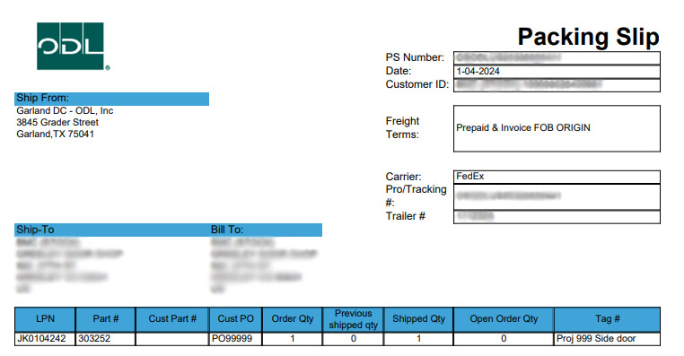
PACKING SLIPS
OLD VERSION
NEW VERSION

Slide 12
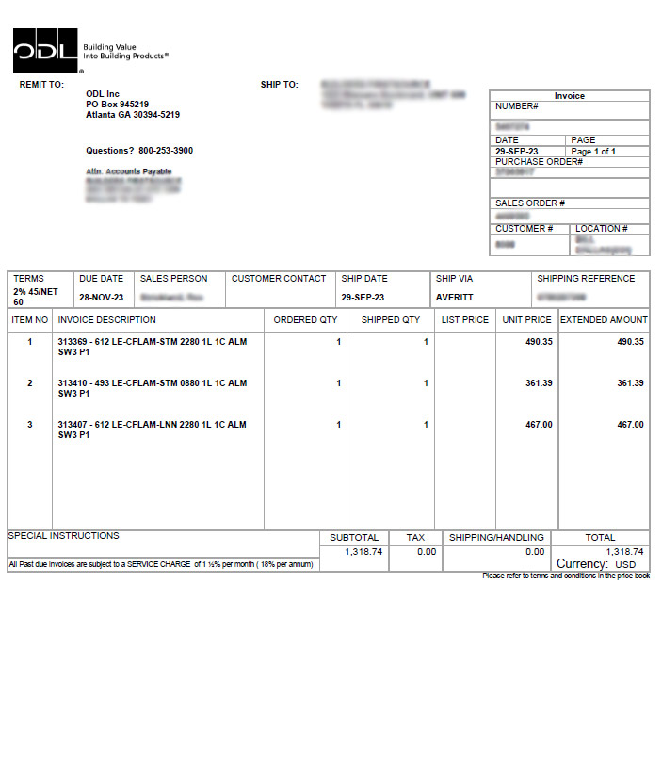
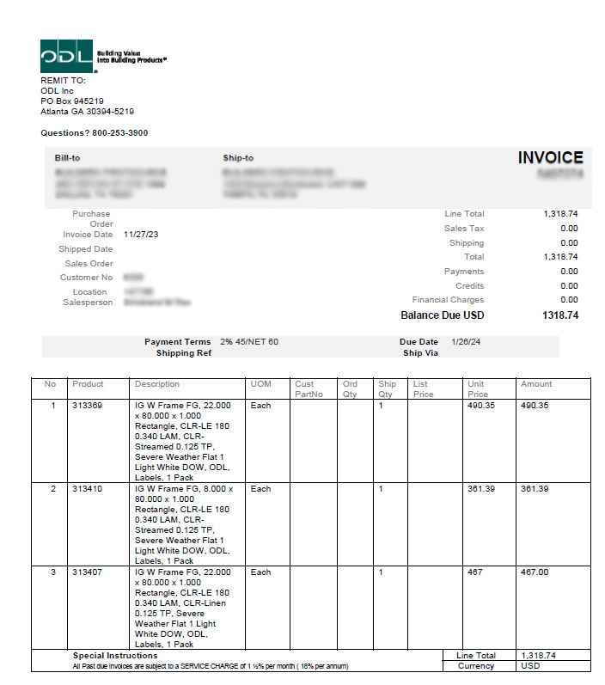
INVOICES
OLD VERSION
NEW VERSION
Notes:
Invoices will have all of the same information, but a different layout.

Slide 13
ITEM DESCRIPTIONS
OLD VERSION
684 CL-LE GBG-5/8 WHT 2236 4L 1C HPSSD EVO P1
IG with Frame, Classic GBG, 22.000 x 36.000 x 1.000 Rectangle, Clear-Low E CS73 0.125 Tempered, Clear-Clear 0.125 Tempered, 4 Light (2w,2h), White Flat 0.625 Bar, Evolve 1 Light White FIPG, ODL, Labels, 1 Pack
NEW VERSION
Notes:
We are moving from heavily “coded” item descriptions to descriptions with more information in plain English. One limitation that you will note is that our new system has some difficulty with fractions, so the decimals may take some getting used to. For example, in this description, you can see that a 5/8” GBG bar is called out as “0.625 bar.”

Slide 14
ITEM DESCRIPTIONS
IG with Frame, Classic GBG, 22.000 x 36.000 x 1.000 Rectangle, Clear-Low E CS73 0.125 Tempered, Clear-Clear 0.125 Tempered, 4 Light (2w,2h), White Flat 0.625 Bar, Evolve 1 Light White FIPG, ODL, Labels, 1 Pack
Generic Product Type, Product Subfamily (Design/Type), Width x Height x Thickness Shape, Surface 1-Surface 2 Pane 1 Glass Thickness Pane 1 Glass Type, Surface 3-Surface 4 Pane 2 Glass Thickness Pane 2 Glass Type, IG Light Configuration (# of lights across, # of lights down), Bar Color Bar Profile Bar Thickness, Frame Type Frame Light Configuration Frame Color Sealant Type, Product Brand, Has Labels, Pack Quantity
Notes:
This is a bit of an eyesore, but it walks through word-by-word what each element of the new item description means. This will vary slightly by the type of product – for example, enclosed blinds will include information about the blind color and operator, and camed units will include information for the float glass and finish type.

Slide 15
ORDER ENTRY EMAIL ADDRESS
OLD VERSION
orders.odl.[CSRfirstname].[CSRlastname]@process.esker.net
pro.orders@odl.com
NEW VERSION
Notes:
Finally, we are changing our order intake email for non-EDI orders to be much simpler. Instead of having different intake emails for each customer service rep, we’ve streamlined the process so that all orders can be sent to pro.orders@odl.com.

Slide 16
Notes:
Thank you in advance for your patience as we upgrade to our new ERP. As a reminder, we will be pausing operations from February 29 through March 4, resuming business as usual on March 5. Please let me know what questions you have for me. Our intent is to make this go as smoothly as possible for you.

